Slide 1

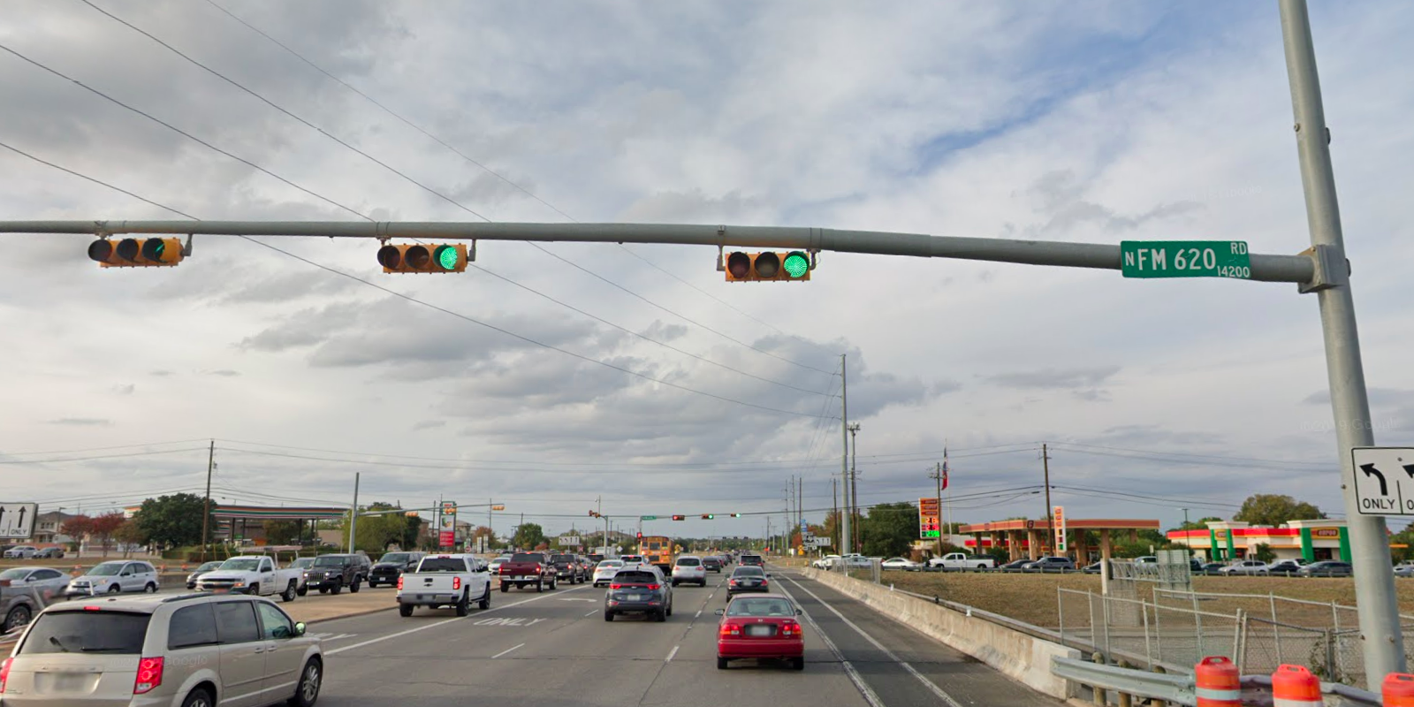
Austin Transportation Department Signs Work Orders
Created By: Susanne Gov Created Date: 2020-08-10 Location Name: FM 620 RD / PARMER LN Intersection ID: 5153208 Cardinal Direction: N
Sign Type | Install/Remove
Street Name Sign | Install

Slide 2
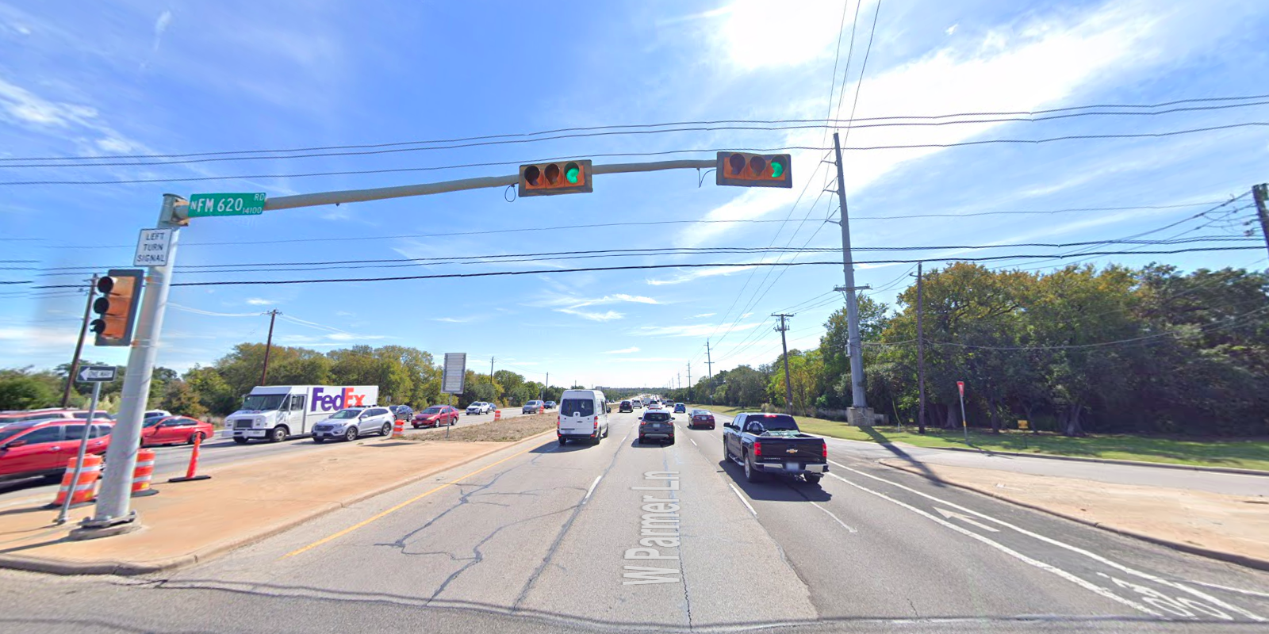
Austin Transportation Department Signs Work Orders
Created By: Susanne Gov Created Date: 2020-08-10 Location Name: FM 620 RD / PARMER LN Intersection ID: 5153208 Cardinal Direction: S
Sign Type | Install/Remove
Street Name Sign | Install
Left Turn Signal | Install

Slide 3
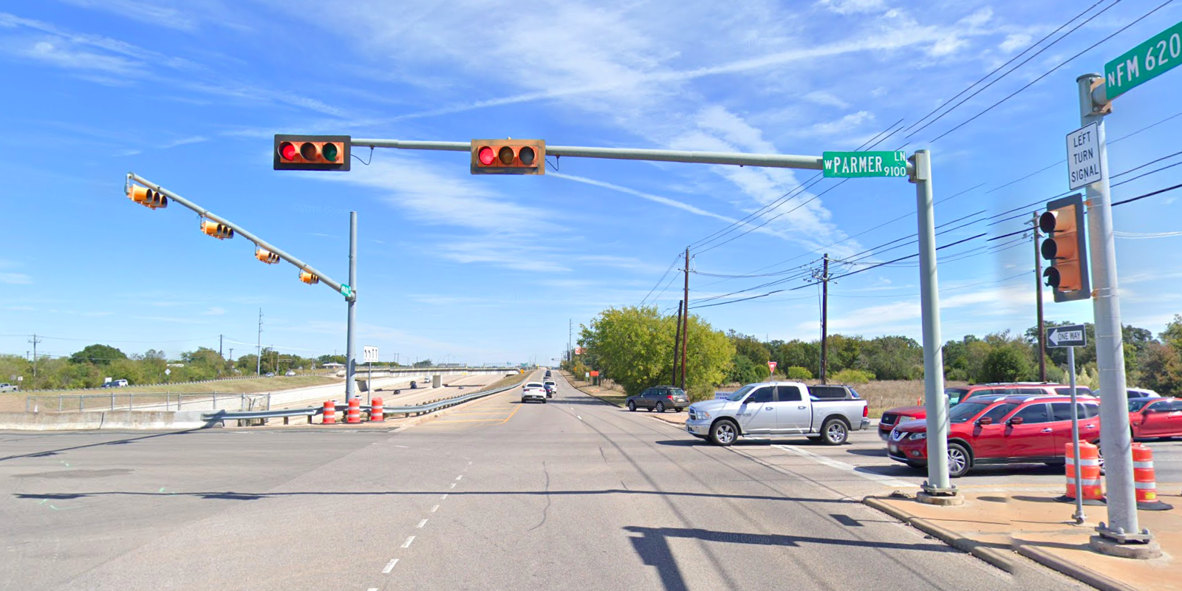
Austin Transportation Department Signs Work Orders
Created By: Susanne Gov Created Date: 2020-08-10 Location Name: FM 620 RD / PARMER LN Intersection ID: 5153208 Cardinal Direction: E
Sign Type | Install/Remove
Street Name Sign | Install

Slide 4
Austin Transportation Department Signs Work Orders
Created By: Susanne Gov Created Date: 2020-08-10 Location Name: FM 620 RD / PARMER LN Intersection ID: 5153208 Cardinal Direction: W
Sign Type | Install/Remove

